Slide 1
ASP MVC

Slide 3
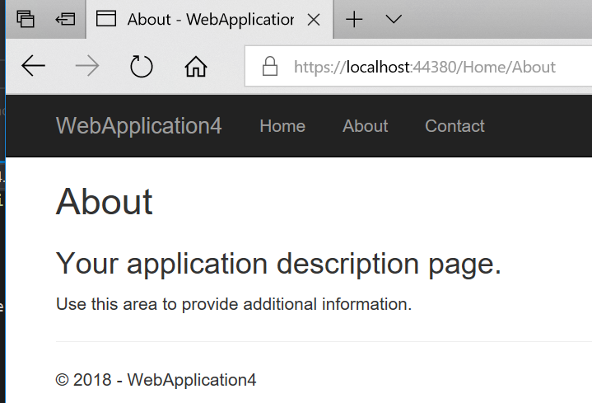

Slide 4
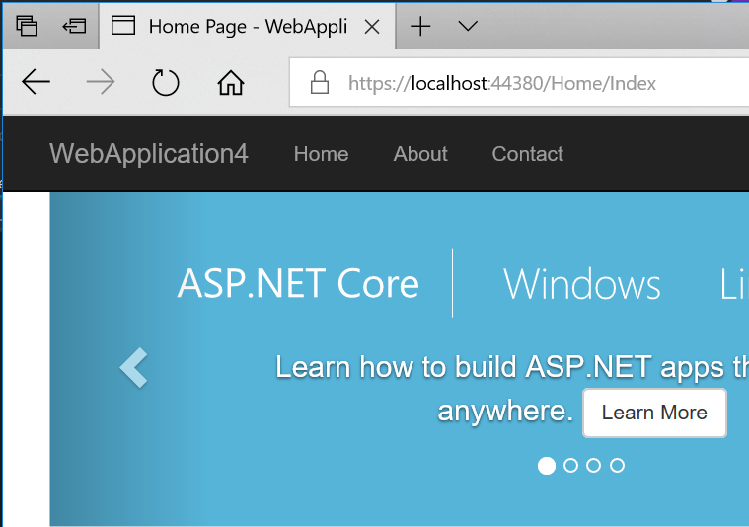
Add to /Home/Index

Slide 5
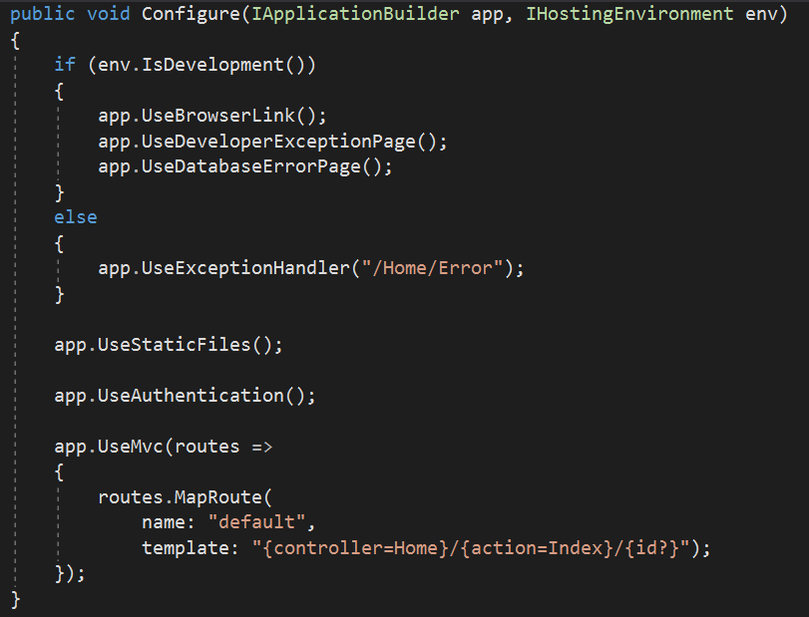
Index is the default page
default template

Slide 6

Change the Index to Home and run

Slide 7
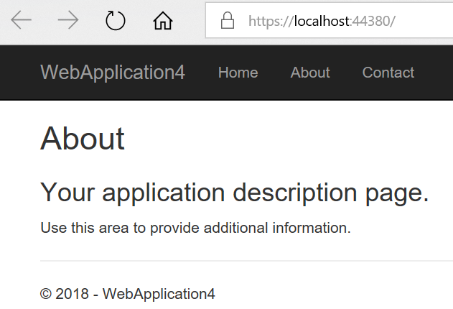
Run your app

Slide 8
Make sure change it to Index

Slide 9
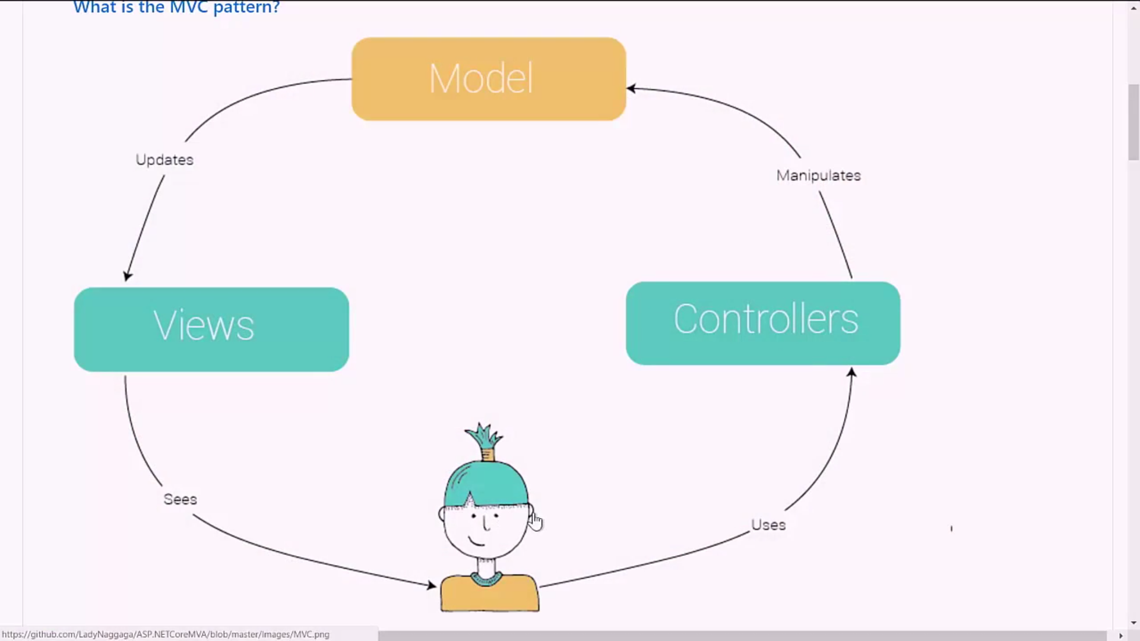
Can be a database or web service
I.e:avaialbe seats
Talk to HTML
Talk to Database or webservices
Open the webpage

Slide 11
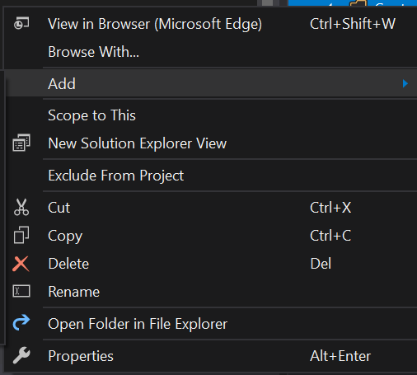

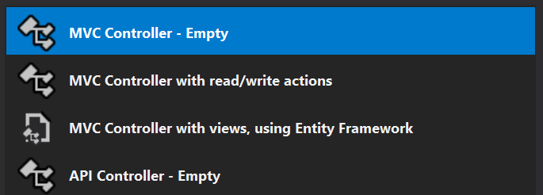
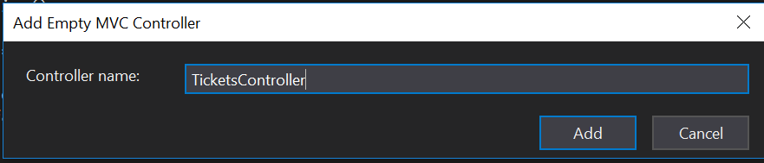
Creating TicketsController
Right click on the Controller folder

Slide 12
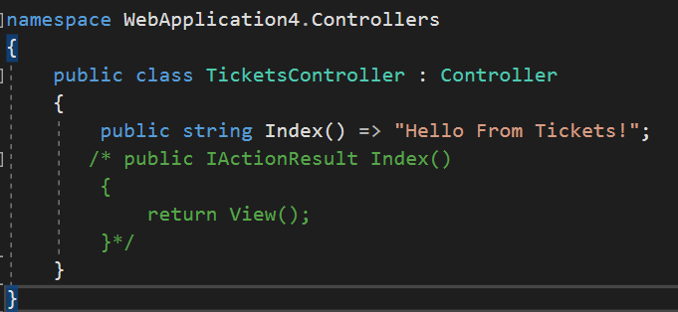
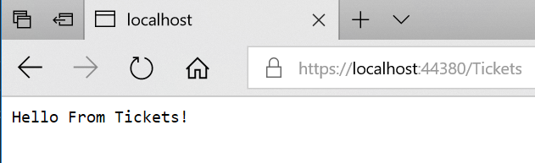
Notes:
public string Index() => "Hello From Tickets!";
/* public IActionResult Index()
{
return View();
}*/

Slide 13
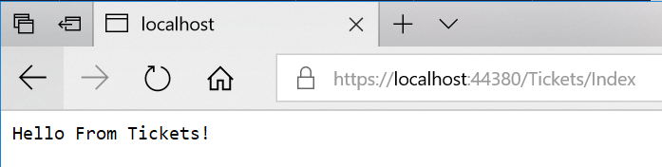

Slide 14

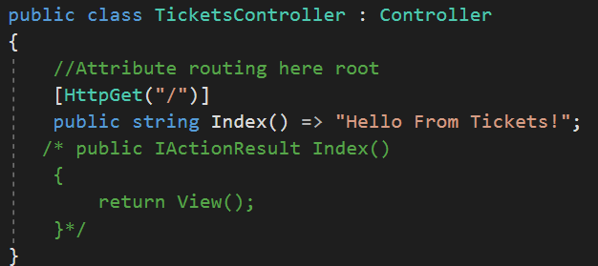
Notes:
//Attribute routing here root
[HttpGet("/")]
public string Index() => "Hello From Tickets!";
/* public IActionResult Index()
{
return View();
}*/

Slide 15
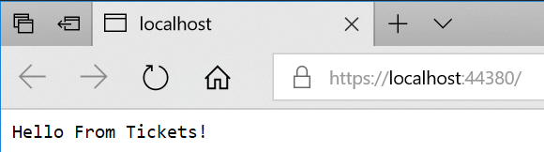

Slide 16
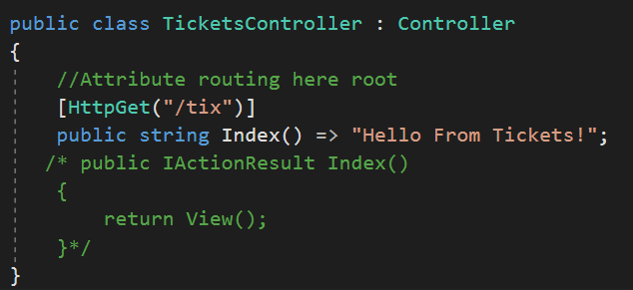
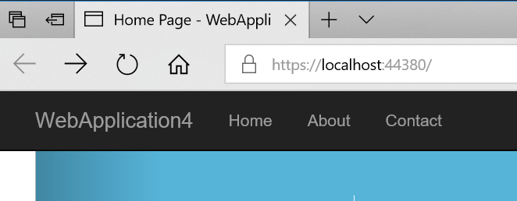
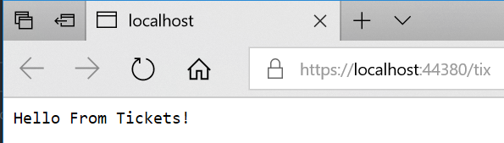
Notes:
//Attribute routing here root
[HttpGet("/tix")]
public string Index() => "Hello From Tickets!";
/* public IActionResult Index()
{
return View();
}*/

Slide 17



Slide 18
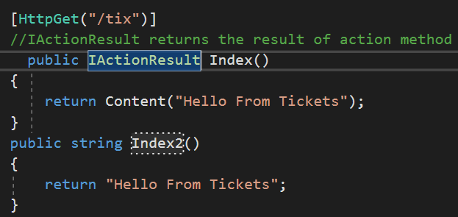
Notes:
[HttpGet("/tix")]
//IActionResult returns the result of action method
public IActionResult Index()
{
return Content("Hello From Tickets");
}
public string Index2()
{
return "Hello From Tickets";
}

Slide 19
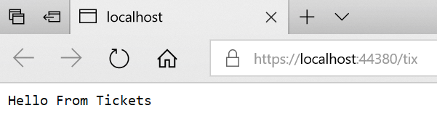
Run your app

Slide 20
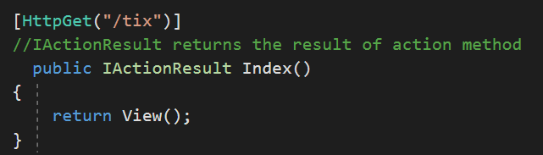
Notes:
[HttpGet("/tix")]
//IActionResult returns the result of action method
public IActionResult Index()
{
return View();
}

Slide 21
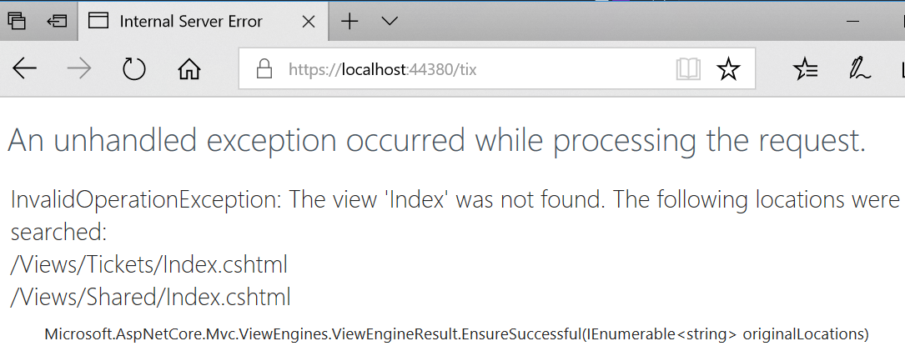
Run app
Can not find the View Tickets

Slide 22
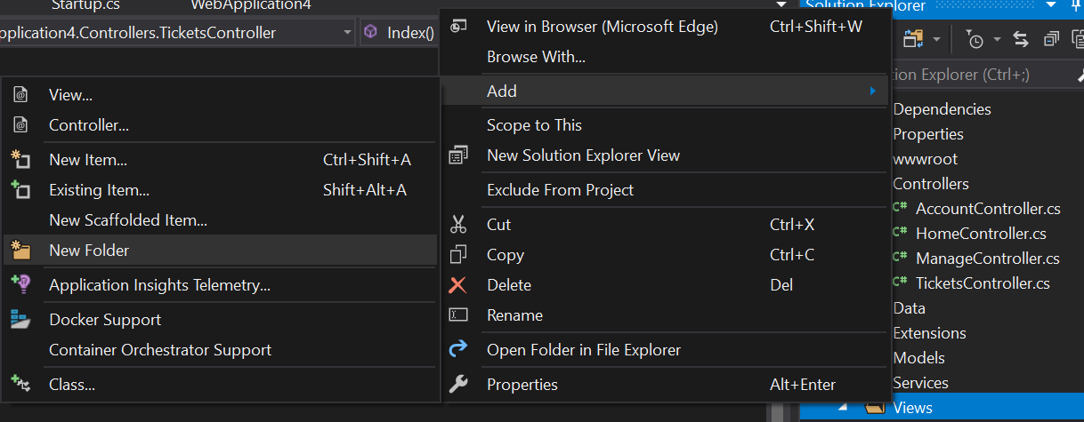
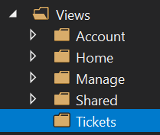
Add a Folder Tickets under Views

Slide 23
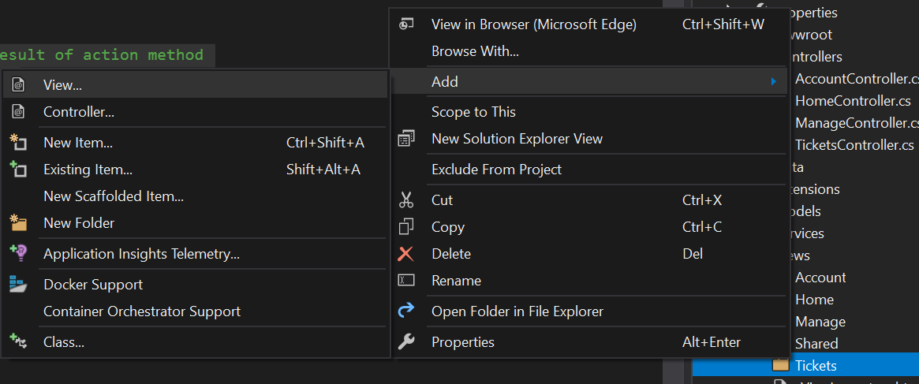

Create a View under Tickets

Slide 24
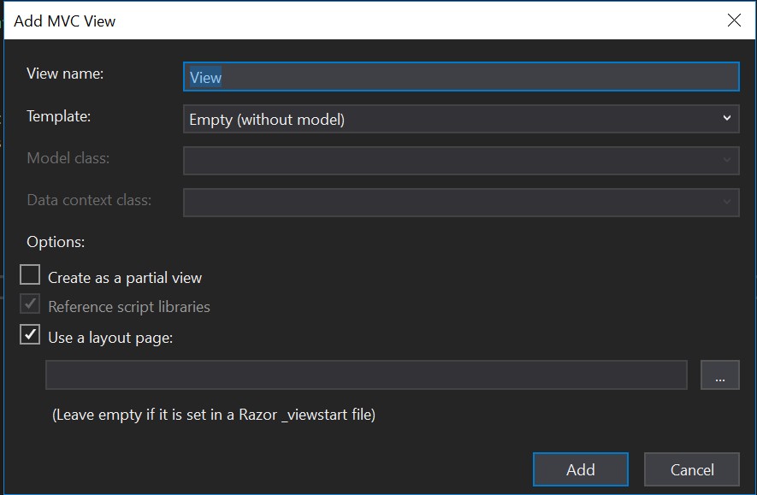
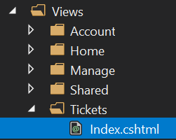

Slide 25

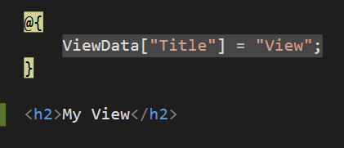

Slide 26
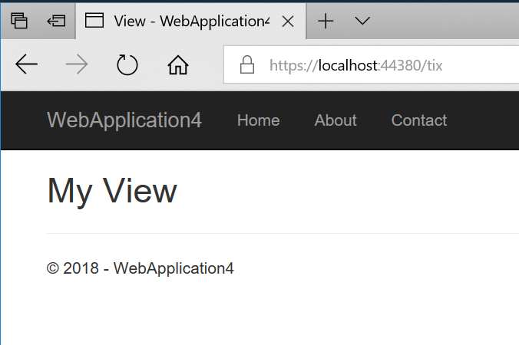

Slide 27
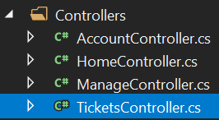
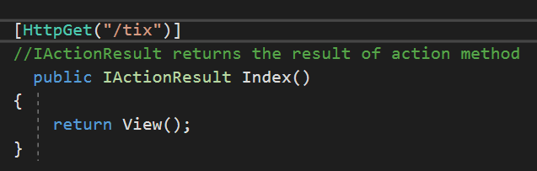
Remember

Slide 28
But where the other parts of the page come from?

Slide 29
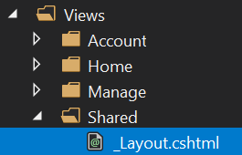
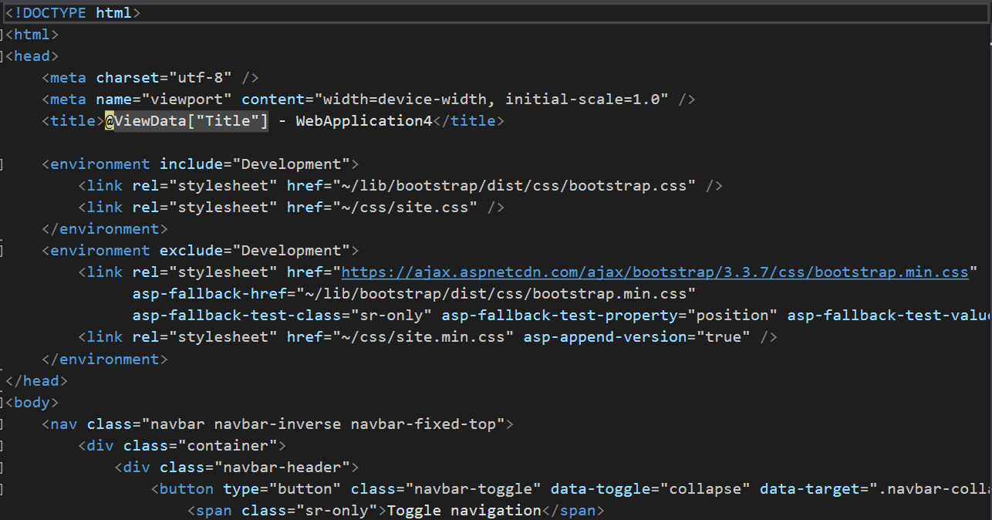
From

Slide 30
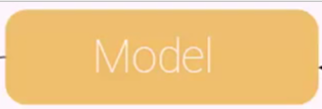
Lets create Model

Slide 31
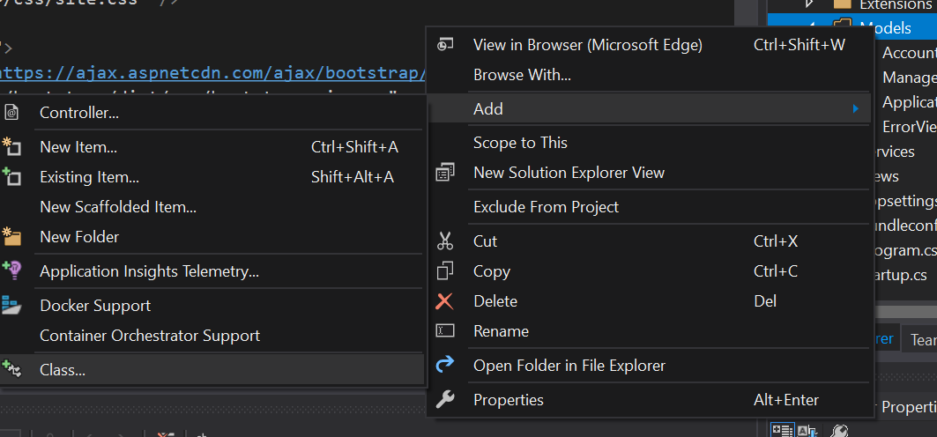

Right click on the Models

Slide 32
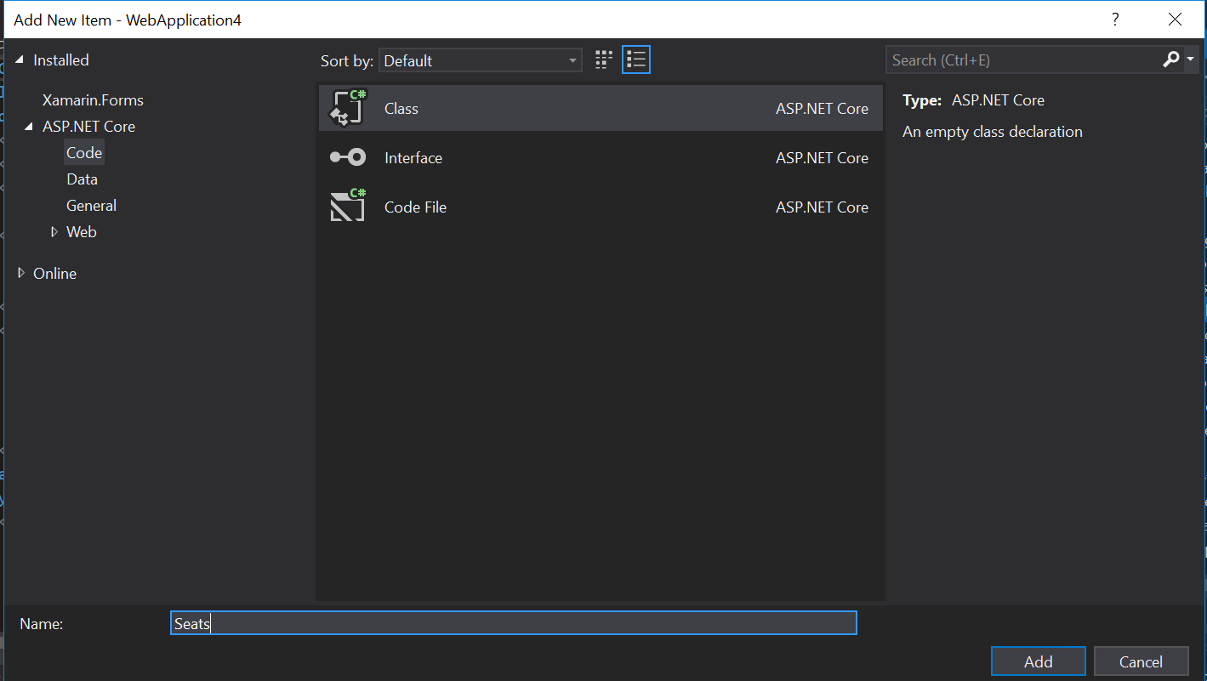

Slide 33
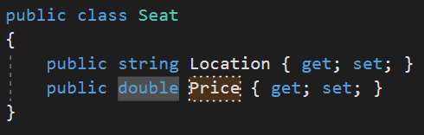
Notes:
public class Seat
{
public string Location { get; set; }
public double Price { get; set; }
}

Slide 34
Back to

Slide 35

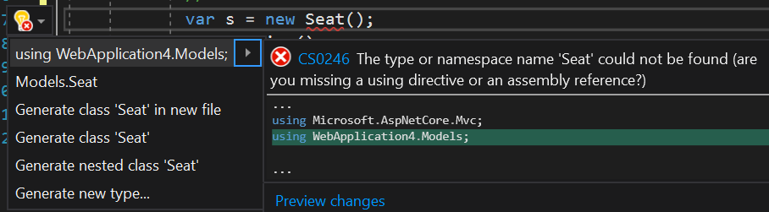
Add the Models under which Seat added

Slide 36
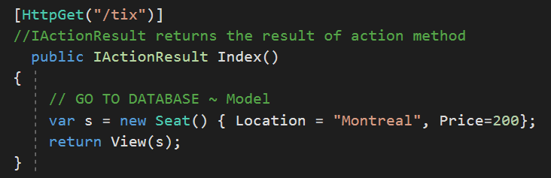
Notes:
[HttpGet("/tix")]
//IActionResult returns the result of action method
public IActionResult Index()
{
// GO TO DATABASE ~ Model
var s = new Seat() { Location = "Montreal", Price=200};
return View(s);
}

Slide 37

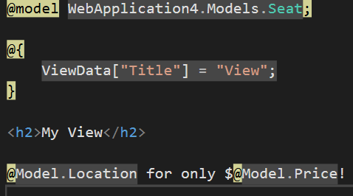
Back to View
Notes:
@model WebApplication4.Models.Seat;
@{
ViewData["Title"] = "View";
}
<h2>My View</h2>
@Model.Location for only $@Model.Price!

Slide 38
